Slide 1
TEXT TO HANDWRITING CONVERTER

Slide 2
TEAMMATE NAMES:- -AVEECK PANDEY(RA2211003010703) -VIJAY MAKKAD(RA2211003010686) -VINEET BIHANI (RA2211003010685)

Slide 3
OBJECTIVE
Amid the rise of digital communication, the attraction towards handwritten expression diminishes. This endeavor seeks to bridge this gap by creating a new deep learning method that generates lifelike handwritten text from digital input. Leveraging generative models, especially conditional generative adversarial networks (cGANs), this system follows a two-step process: it converts typed text into realistic handwritten images, then refines these images to capture handwriting's natural nuances.

Slide 4
APPROACH
To ensure accuracy, a dataset pairs digital text with real handwritten samples for training. The cGAN framework learns intricate patterns, stroke variations, and context. Balancing legibility and style is essential, enabling users to personalize handwriting while maintaining readability.
Performance assessment involves quantitative and qualitative measures, including stroke similarity and character recognition, alongside user surveys. Beyond personal use, this research impacts design, branding, and art, blending digital convenience with handwritten warmth to revive timeless expression in the modern tech era.

Slide 5
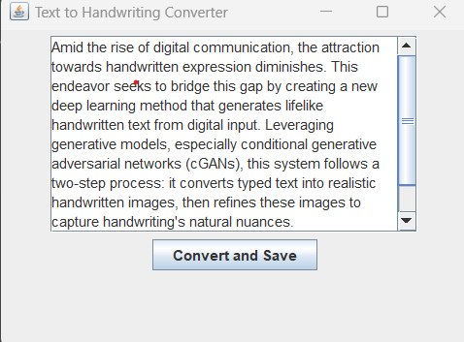
WORKING
We started working with the framework of the GUI using javaframework creating a pop up that gives us the basic requirements needed to take input from user and convert it into a different handwriting . The project also intends to give the user a feel of nostalgia and authenticity while writing through the program which we give output as a PNG file which can be used according to the user , there are no word limits and neither is there a limit on the number of pages we want to convert.

Slide 6
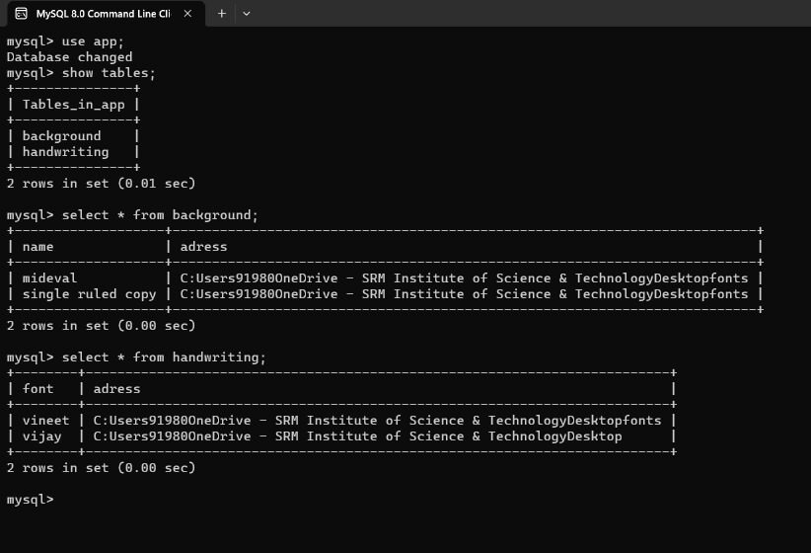
GLIMPSE OF THE DATABASES
1 DATABASE
2 TABLES
DIFFERENT FONTS
DIFFERENT HANDWRITING

Slide 7
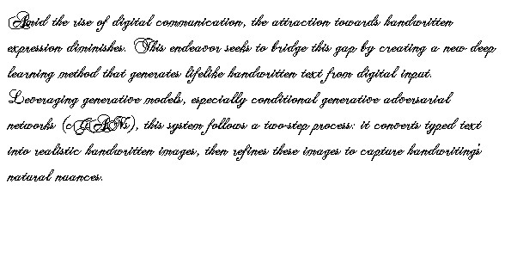
OUTPUT
This is an example of the above written objective converted into a different font on a blank piece of paper

Slide 8
THANK YOU

